Slide 1
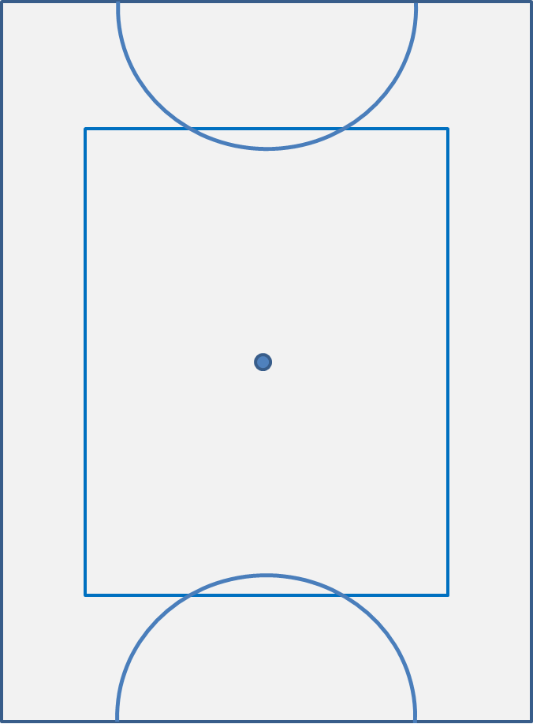
This time we will talk about when the puck is in the corner area close to our goal (shown in orange)
As always different teams have different ways of defending their corners. I will just explain my way.
This is not the best place for the puck to be but it is also not the worst!
As a team we want to advance the puck up the pool but keeping it contained on or close to the wall.
Be wary of trying to break out in the direction of the red arrows. If you lose the puck you will be giving the opposition a very good chance to score!!

Slide 2
BACKLINE
You need to decide whether you want to employ a 3-way or 2-way rotation in this situation.
Both have their merits.
With a 3 way rotation you are sharing quite a heavy workload between 3 people.
With a 2 way rotation you always have a fresh player on the goal and alert to danger.
CB
LB
RB
Here is the 3 way.
And here is the 2 way.
If you use a three way, make sure you rotate right back to the goal before you come down again.
In both rotations, if you are the next to go, GO. If you hang around the other backs wont be able to fill in behind you and you will likely give the opposition some free yards!

Slide 3
FORWARDS
RF - You should be 1m in front of the puck, either waiting to receive the pass if our team has it, or ready to back tackle if their team has it
- If you get the puck swim it as far up the wall as you can, but KEEP IT CLOSE TO THE WALL.
- It is more important here that you keep the puck safe than try and make loads of ground up the wall.
- Slow the game down until we can gather as a team and make a combined effort to get the puck up the pool
CB
LB
RB
RF
C
LF

Slide 4
FORWARDS
LF - As we progress further up the side wall you should get closer to the play (as shown)
- If the opposition are making ground you should drop back and cover the space in front of the goal but try not to get in the way of the backline rotation
CB
LB
RB
RF
C
LF

Slide 5
FORWARDS
LF - As we progress further up the side wall you should get closer to the play (as shown)
- If the opposition are making ground you should drop back and cover the space in front of the goal but try not to get in the way of the backline rotation
CB
LB
RB
RF
C
LF
LB
CB
- Remember the opposition would rather attack the goal head on so they may try a backline switch here.
- It is crucial that as soon as this develops you rush at their back man so that they cannot make easy ground (as shown)
RB

Slide 6
FORWARDS
C - You have a similar role to the LF here
- You need to cut out any backward diagonal passes that the opposition may try to make
CB
LB
RB
LF
RF
RF
C
LF
C
LB
CB
RB

Slide 7
FORWARDS
C - You have a similar role to the LF here
- You need to cut out any backward diagonal passes that the opposition may try to make
- If you get the puck, the safe option is to fire it back onto the wall and STAY DOWN!
CB
LB
RB
LF
RF
RF
C
LF
C
LB
CB
RB

Slide 8
FORWARDS
C - You have a similar role to the LF here
- You need to cut out any backward diagonal passes that the opposition may try to make
- If you get the puck, the safe option is to fire it back onto the wall and STAY DOWN!
- A very risky but sometimes lucrative option is to flick to your LF and have them swim to the other side of the pool. Exercise caution before trying this and stay with your LF as they will invariably need your help!!
CB
LB
RB
RF
C
LF
RB

Slide 9
The play is the same but flipped on the other side of the pool
OVERALL:
Backs – Decide whether you want to employ 2 way or 3 way rotation and don’t let them down that back wall!!!
RF - Be there!! Its tiring I know but if you are not on the bottom it is very difficult to get out of this situation
C and LF - Stop the opposition getting the puck into the centre (unless you’re feeling risky and want to try a swim across the pool!!)
Watch the last minute of the World Championship final http://www.youtube.com/watch?v=R70MmPWPPyg
The French are 2-1 up and down to 5 men. They keep the puck in the corner/close to the wall to close out the game and win gold!

