Slide 1
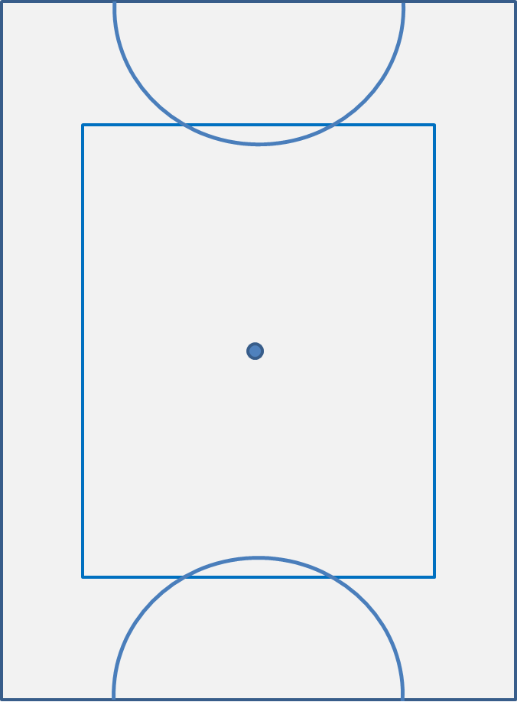
This power point deals with attacking corners (orange area)
This can be a frustrating and difficult area of the pool to score from. But can be a useful place to be if you are a goal or two up and want to close a game out.

Slide 2
This power point deals with attacking corners (orange area)
This can be a frustrating and difficult area of the pool to score from. But can be a useful place to be if you are a goal or two up and want to close a game out.
As a team we should be trying to get the puck more into the centre of the pool so we can attack the goal head on. This may require us to bring the puck back before we can then go forward again.

Slide 3
This power point deals with attacking corners (orange area)
This can be a frustrating and difficult area of the pool to score from. But can be a useful place to be if you are a goal or two up and want to close a game out.
As a team we should be trying to get the puck more into the centre of the pool so we can attack the goal head on. This may require us to bring the puck back before we can then go forward again.
Alternatively you may wish to just get physical and try and smash the other team down the back wall!!
This is less risky but will require a lot more muscle power and committed bodies to be successful!!

Slide 4
FORWARDS
RF - You need to be down as much as
possible here and close to the puck
- When you get the puck, decide whether you are going to try and smash it along the back wall, look diagonally inside for your centre or behind for your half back. What you do here will depend on your team strategy for the specific game and
the circumstance you find yourself in
LB
CB
RB
C
RF
LF

Slide 5
FORWARDS
C - You need to dominate the area shown in orange
- Try not to get sucked on to either wall and focus on picking up any pucks that come just off the wall
- If you get it you will not have much time!! Drive hard at the goal or look for your LF or an overlapping LB.
LB
CB
RB
C
RF
LF

Slide 6
FORWARDS
LF - Sit on the corner of the goal and mess up the oppositions back line rotation by taking up as much space as possible. You will scare them just with your presence!
- If they try a cheeky backline switch to get out of jail, YOU need to be there to punish them
- If we do manage to smash it along the back wall, you need to be there to finish it off
- Benson Taylor and Steve Kars are two players that execute this role annoyingly well
LB
CB
RB
C
RF
LF

Slide 7
BACKS
RB and CB - You are the work horses of this situation
- You need to rotate quickly with one another both along the side wall
LB
CB
RB
C
RF
LF

Slide 8
BACKS
RB and CB - You are the work horses of this situation
- You need to rotate quickly with one another both along the side wall and down the back wall
LB
C
CB
RB
RF
LF

Slide 9
BACKS
RB and CB - You are the work horses of this situation
- You need to rotate quickly with one another both along the side wall and down the back wall
- It is a good idea to cut inside here before you get too close to the corner
LB
CB
RB
C
RF
LF

Slide 10
BACKS
RB and CB - You are the work horses of this situation
- You need to rotate quickly with one another both along the side wall and down the back wall
- It is a good idea to cut inside here before you get too close to the corner
- Or you may want to look inside for your C
LB
CB
RB
C
RF
LF

Slide 11
BACKS
RB and CB - You are the work horses of this situation
- You need to rotate quickly with one another both along the side wall and down the back wall
- It is a good idea to cut inside here before you get too close to the corner
- Or you may want to look inside for your C
- Or start a backline switch
LB
CB
RB
C
RF
LF

Slide 12
BACKS
LB - You have an important role here as the only player not directly involved in the play
LB
CB
RB
C
RF
LF

Slide 13
BACKS
LB - You have an important role here as the only player not directly involved in the play
- Defensively you need to be able to cover a break out up the side wall and a break out wide
LB
CB
RB
C
RF
LF

Slide 14
BACKS
LB - You have an important role here as the only player not directly involved in the play
- Defensively you need to be able to cover a break out up the side wall and a break out wide
LB
CB
RB
C
RF
LF

Slide 15
BACKS
LB - You have an important role here as the only player not directly involved in the play
- Defensively you need to be able to cover a break out up the side wall and a break out wide
- When we are in possession you need to be available for the switch from your CB or from your C
LB
CB
RB
C
RF
LF

Slide 16
BACKS
LB - You have an important role here as the only player not directly involved in the play
- Defensively you need to be able to cover a break out up the side wall and a break out wide
- When we are in possession you need to be available for the switch from your CB or from your C
LB
CB
RB
C
RF
LF

Slide 17
BACKS
LB - You have an important role here as the only player not directly involved in the play
- Defensively you need to be able to cover a break out up the side wall and a break out wide
- When we are in possession you need to be available for the switch from your CB or from your C
- As the puck moves along the back wall you need to edge closer to the goal while still covering any break outs (as shown)
- You will often be the one to finish the goal if you have good positioning
Jesse scored the first goal in their final against France by doing exactly this: http://www.youtube.com/watch?v=R70MmPWPPyg
LB

Slide 18
OVERALL
Decide before each game how you plan to attack a team when the puck goes into the corner. Are you going to muscle them down the back wall? Back line switch? Or look for the centre?
Different opposition will require different tactics!
Unless you plan to attack down the back wall, don’t tire yourself by over harassing an opposition who is holding it in the corner.
There is a rule that means they must bring it away from the corner after just one rotation. So, set up as a team and let them bring it to you!!
If you are a goal or two up and there is not long left, just keep it in the corner and watch the clock roll down.

